Slide 1

BASIS DATA - TI14KB21
Meeting 2
Database Architecture
Bagus Kristomoyo Kristanto S.Kom , M.MT
bagus.kristanto@stiki.ac.id

Slide 2
Outline
01
Database Architecture
Purpose of three-level database architecture.
02
Database Life Cycle
Development process for creating database based on requirement
03
Centralized vs Distributed Database
Pro Cons Centralized and Distributed Database
04
Quiz
.

Slide 3
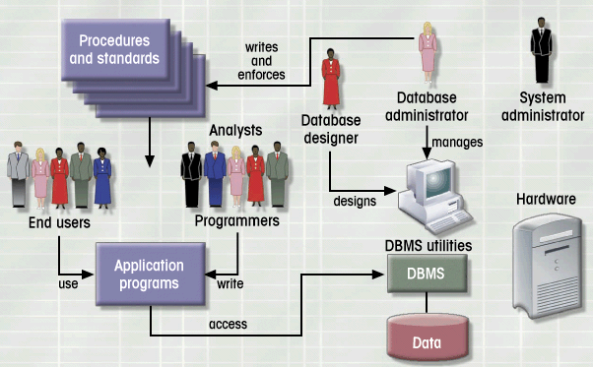
Database Environtment

Slide 4
Why Use Database
Purpose of Database
01
Optimizes data management
Transform data to information
Functions of DBMS/Database System
03
Stores data and related data entry forms,
report definitions
Hides the complexities of relational database model from the user
Enforces data integrity
Implements data security management
Importance of Database Design
02
Defines the database’s expected use
Avoid data redundancy & ensure data integrity
Poorly designed database generates errors

Slide 5
How to Develop Database
02
Design
From conceptual design to a detailed system specification
01
Planning & Analysis
Assess
Goal of the organization
Database environment
Identify
Database needs
User needs and characteristics
Database system requirements
03
Implementation
Create the database
02
04
Maintenance
Troubleshoot, update, streamline the database

Slide 6
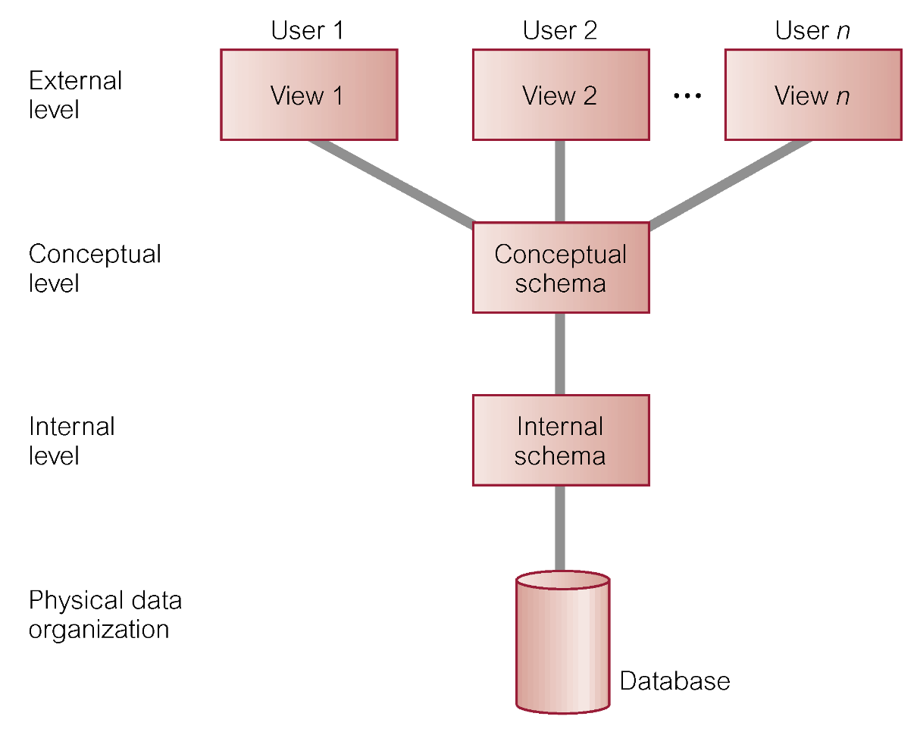
Three Level Database Architecture
Database

Slide 7
Three Level Database Architecture Details
 | External Level
 | Users’ view of the database. Describes that part of database that is relevant to a particular user
 | Conceptual Level
 | Community view of the database. Describes what data is stored in database and relationships among the data.
 | Internal Level
 | Physical representation of the database on the computer. Describes how the data is stored in the database.

Slide 8
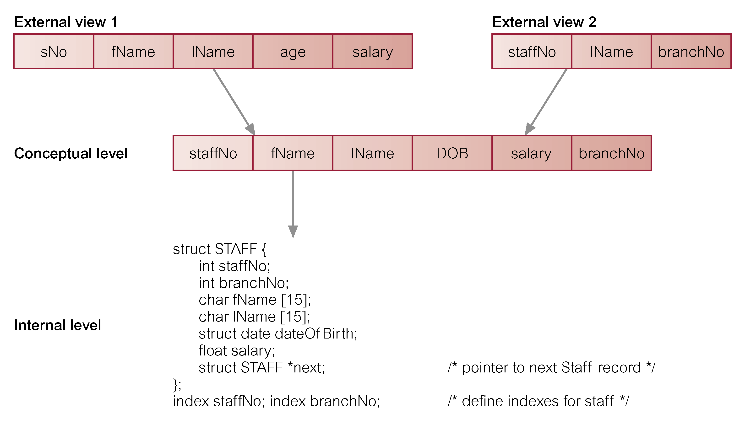
Three Level Database Architecture Example

Slide 9

Database Modeling
Abstraction of complex real-word data structures in relative simple (graphical) representations
Facilitate interaction among the designer, the applications programmer, and the end user
Entity
Attribute
Relationship
Constraint
thing about which data are to be collected and stored
a characteristic of an entity
describes an association among entities
restrictions placed on the data

Slide 10
Evolution of Database Model
Timeline of Database modeling
Network
Object-oriented
1960s
1970s
1980s
1990s
2000s
File-based
Hierarchical
Relational
Entity-Relationship
Web-based

Slide 11
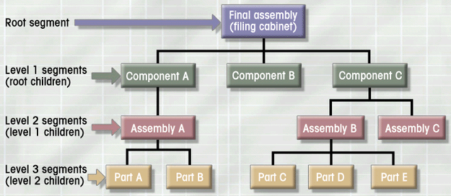
Hierarchical
Database
Database
Background
Developed to manage large amount of data for complex manufacturing projects
e.g., Information Management System (IMS)
IBM-Rockwell joint venture
clustered related data together
hierarchically associated data clusters using pointers
Hierarchical Database Model
Assumes data relationships are hierarchical
One-to-Many (1:M) relationships
Each parent can have many children
Each child has only one parent
Logically represented by an upside down tree

Slide 12
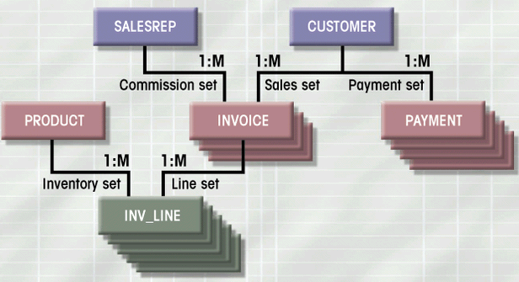
Network
Database
Database
Objectives
Represent more complex data relationships
Improve database performance
Impose a database standard
Network Database Model
Similar to Hierarchical Model
Records linked by pointers
Composed of sets
Each set consists of owner (parent) and member (child)
Many-to-Many (M:N) relationships representation
Each owner can have multiple members (1:M)
A member may have several owners

Slide 13
Problems with legacy database systems
Required excessive effort to maintain
Data manipulation (programs) too dependent on physical file structure
Hard to manipulate by end-users
No capacity for ad-hoc query (must rely on DB programmers).
Evolution in Data Organization
E. F. Codd’s Relational Model proposal
Separated the notion of physical representation (machine-view) from logical representation (human-view)
Considered ingenious but computationally impractical in 1970
Relational Database Model
Dominant database model of today
Eliminated pointers and used tables to represent data
Tables
flexible logical structure for data representation
a series of row/column intersections
related by sharing common entity characteristic(s)
Relational
Database
Database

Slide 14
Provides a logical “human-level” view of the data and associations among groups of data (i.e., tables)
Example :
Relational
Database
Database

Slide 15
Peter Chen’s Landmark Paper in 1976
“The Relationship Model: Toward a Unified View of Data”
Graphical representation of entities and their relationships
Entity Relationship (ER) Model
Based on Entity, Attributes & Relationships
Entity is a thing about which data are to be collected and stored
e.g. EMPLOYEE
Attributes are characteristics of the entity
e.g. SSN, last name, first name
Relationships describe an associations between entities
i.e. 1:M, M:N, 1:1
Complements the relational data model concepts
Helps to visualize structure and content of data groups
entity is mapped to a relational table
Tool for conceptual data modeling (higher level representation)
Represented in an Entity Relationship Diagram (ERD)
Formalizes a way to describe relationships between groups of data
Entity
Relational
Database
Database

Slide 16
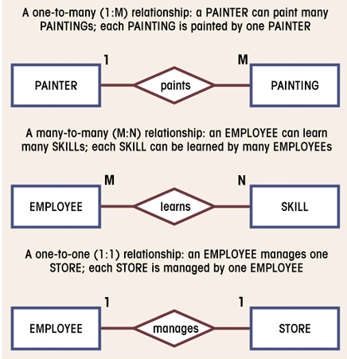
Entity
represented by a
rectangle with its name in capital letters.
Relationships
represented by
an active or passive
verb inside the
diamond that connects the related entities.
Connectivities
i.e., types of relationship written next to each entity box.
E-R
Diagram: Chen Model
Database

Slide 17
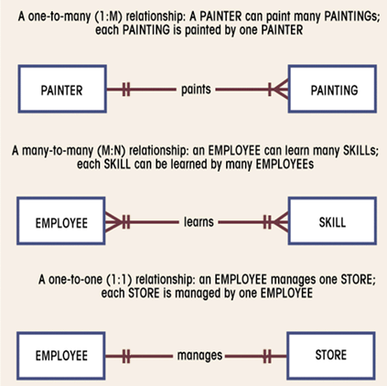
Entity
represented by a rectangle with its name in capital
letters.
Relationships
represented by an active or passive verb that connects the related entities.
Connectivities
indicated by symbols next
to entities.
2 vertical lines for 1
“crow’s foot” for M
E-R
Diagram Crow’s Foot Model
Database

Slide 18
Semantic Data Model (SDM)
Modeled both data and their relationships in a single structure (object)
Developed by Hammer & McLeod in 1981
Object-oriented concepts became popular in 1990s
Modularity facilitated program reuse and construction of complex structures
Ability to handle complex data types (e.g. multimedia data)
Object-Oriented Database Model (OODBM)
Maintains the advantages of the ER model but adds more features
Object = entity + relationships (between & within entity)
consists of attributes & methods
attributes describe properties of an object
methods are all relevant operations that can be performed on an object
self-contained abstraction of real-world entity
Class = collection of similar objects with shared attributes and methods
e.g. EMPLOYEE class = (employ1 object, employ2 object, …)
organized in a class hierarchy
e.g. PERSON > EMPLOYEE, CUSTOMER
Incorporates the notion of inheritance
attributes and methods of a class are inherited by its descendent classes
Object
Oriented
Database

Slide 19
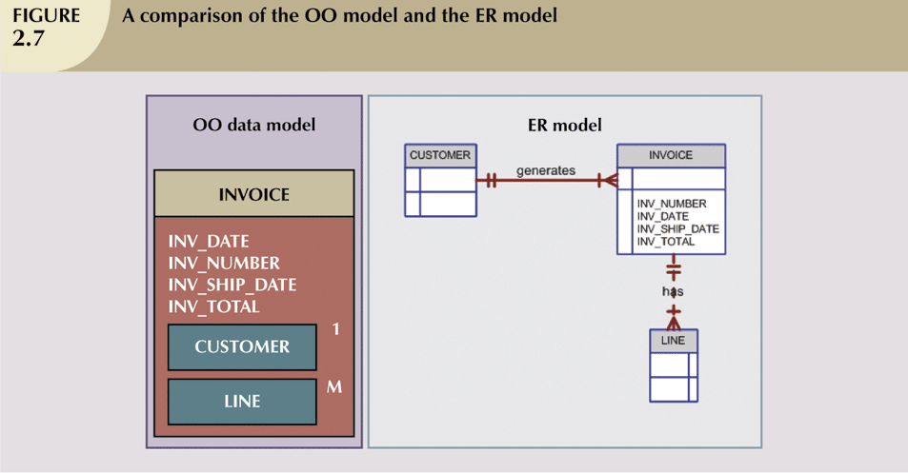
OODBM: - can accommodate relationships within a object - objects to be used as building blocks for autonomous structures
OO Database Model
vs.
E-R Model

Slide 20
Database Lifecycle
01
Application design
02
Physical Creation
03
Conversion
04
Integration
05
Operation
06
Growth change & Maintenance

Slide 21
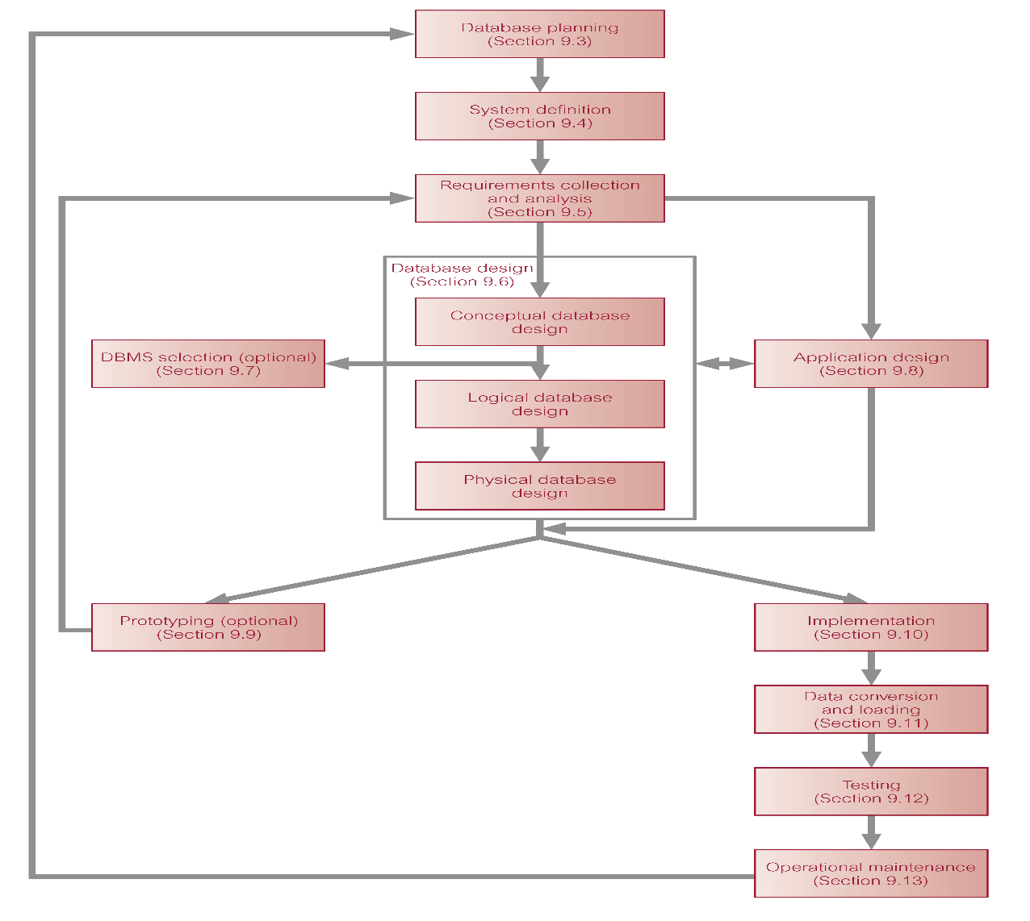

Database
Lifecycle

Slide 22
Identifying the vital entities for the enterprise
Identifying potential application for the database
1
2
Defining The entities And the relationship
Design
Steps Of Database Project
Building a data dictionary
3
4
Building a conceptual model , a logical model , and a physical model
5
Review & evaluation
6

Slide 23
Three Importance Things of Database Design
Conceptual Design
Context Diagram DFD ( Data Flow Diagram ) Model Entity Relationship
Logical Design
Translating ER model to Relational Model
Physical Design
Creation of databases, relationships, and any related things with physical form

Slide 24
Context Diagram
Bagian
Penjualan
Laporan penjualan
Daftar rencana pembayaran
Sistem
Pembayaran
Royalti
Transfer
Manajer
Keuangan
Bank
Persetujuan
Bukti transfer
Surat pemberitahuan
Pengarang

Slide 25
Data Flow Diagram
Laporan penjualan
1
Mencatat
buku terjual
Data buku terjual
Catatan royalti
Jadwal pembayaran
Royalti terbayar
Waktu pembayaran
Royalti belum terbayar
Daftar rencana pembayaran
2
Membuat
Laporan royalti
Jatuh tempo
Royalti belum terbayar
Ringkasan royalti
Transfer
3
Memproses
pembayaran
Data pengarang
Bukti transfer
Nomor rekening
Pengarang
Surat pemberitahuan
Rekening bank
Pembayaran

Slide 26
Distributed vs Centralized Database
PRO CONS
Increased Reliability / Availability
Software Cost and Complexity
Local control over data
Processing Overhead
Modular Growth
Data Integrity Exposure
Lower Communication Cost
Slower Response for Certain Queries
Faster Response for certain Queries

Slide 27
Centralized Database System

Slide 28
Distributed Database System

Slide 29
Run on a single computer system and do not interact with other computer systems
General-purpose computer system: one to a few CPUs
and a number of device controllers that are connected through a common bus that provides access to shared memory
Single-user system (e.g., personal computer or workstation) : desk-top unit, single user, usually has only one CPU
and one or two hard disks; the OS may support only one
user
Multi-user system: more disks, more memory, multiple CPUs, and a multi-user OS. Serve a large number of users who are connected to the system vie terminals. Often called server systems.
Centralized
Database

Slide 30
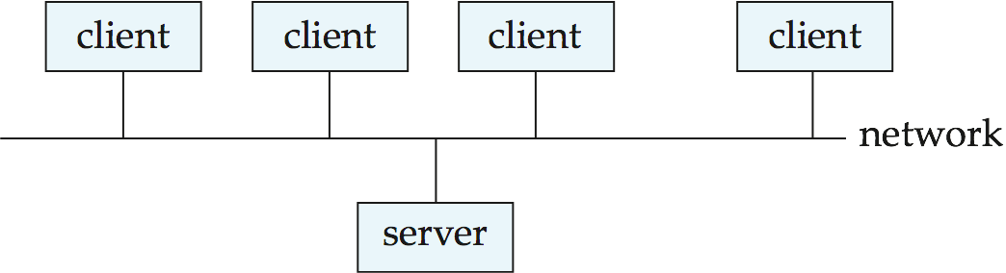
Server systems satisfy requests generated at m client systems, whose general structure is shown below:
Client-Server Systems

Slide 31
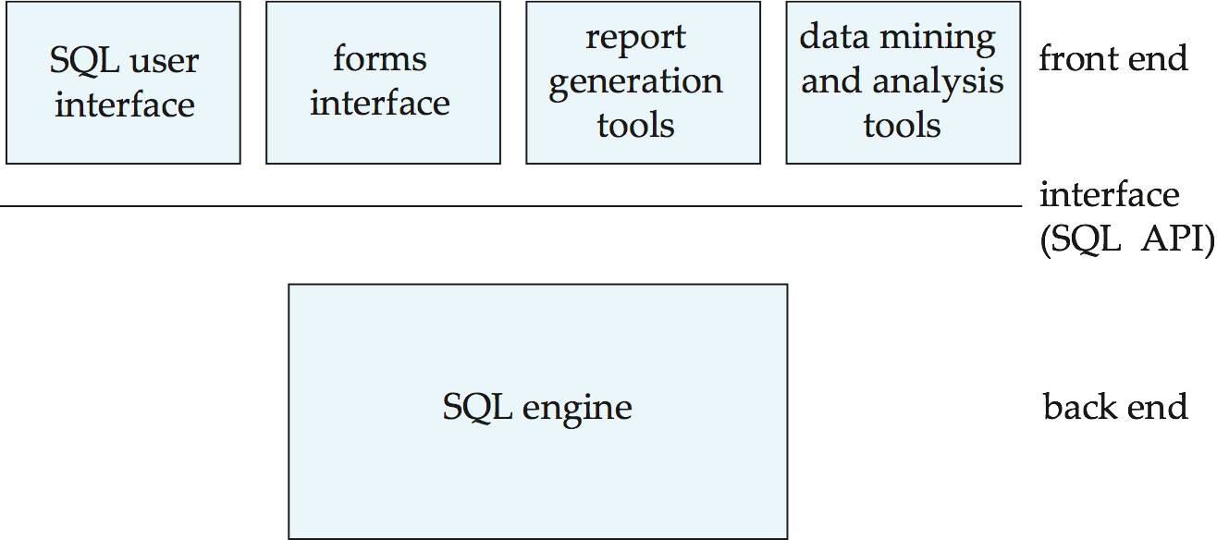
Database functionality can be divided into:
Back-end: manages access structures, query evaluation and optimization, concurrency control and recovery.
Front-end: consists of tools such as forms, report-writers, and graphical user interface facilities.
The interface between the front-end and the back-end is thro-ugh SQL or through an application program interface.
Client-Server Systems

Slide 32
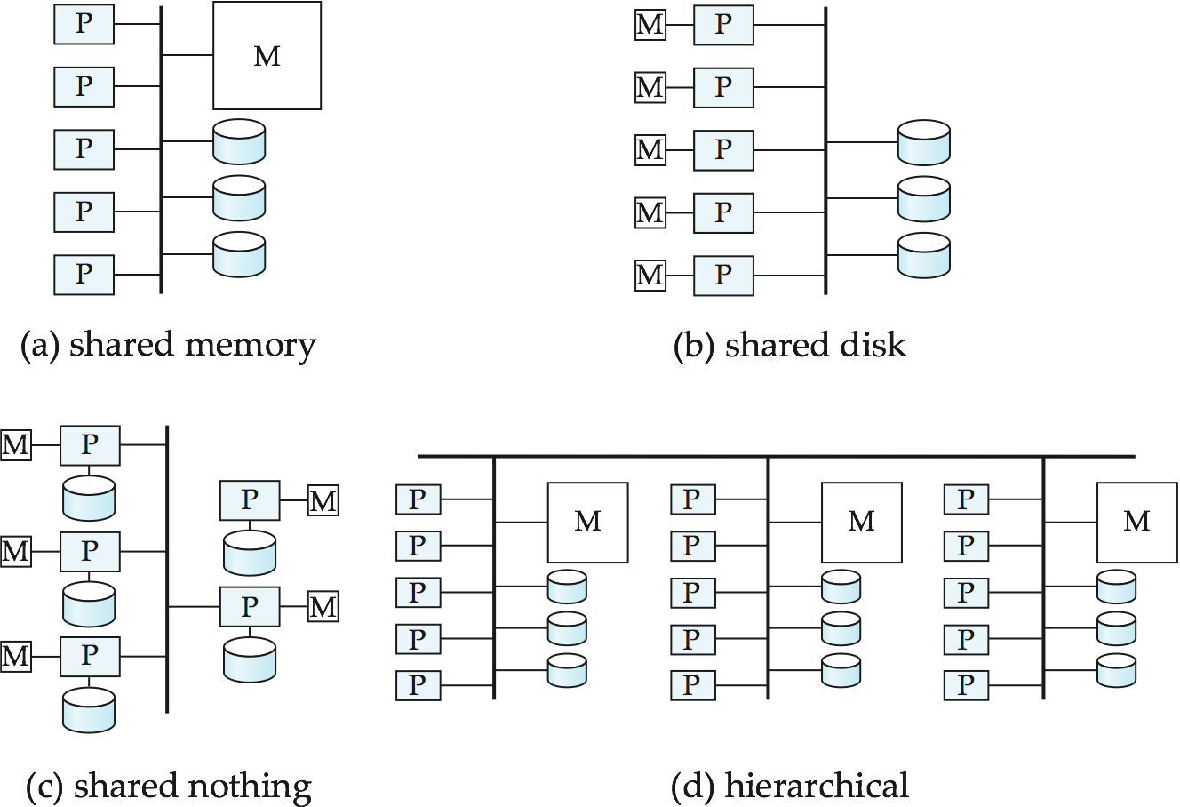
Shared memory -- processors share a common memory
Shared disk -- processors share a common disk
Shared nothing -- processors share neither a common memory nor common disk
Hierarchical -- hybrid of the above architectures
.
Parallel
Database
Architectures

Slide 33
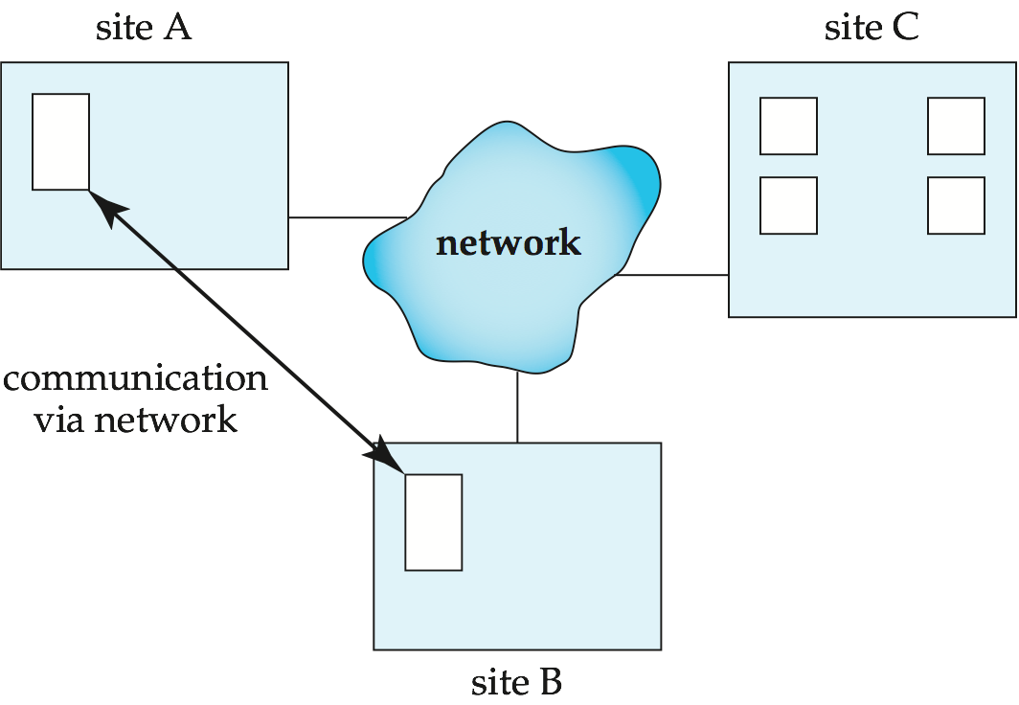
Data spread over multiple machines (also referred to as sites or nodes).
Network interconnects the machines
Data shared by users on multiple machines
Distributed
Systems

Slide 34
QUIZ TIME
INDIVIDUAL QUIZ

Slide 35
Quiz Time :
Define a database model ( chen / crow’s foot ) based on case studies below (choose one )
Academic System Information
( Student, courses, Lecturer, course schedule )
E-Commerce
( User, Seller, items, transaction )
1
Design
Steps Of Database Project

Slide 36
Thank you

